Slide 1
End-of-Life Management of Photovoltaic Panels: Trends in PV Module Recycling Technologies
Introduction
When a product cannot be repaired or reused, recycling is the next best option.
In the case of PV modules, recycling has become an important emerging topic and various activities have been conducted and developed.
The purpose of this study is to provide an international survey of trends related to the development of PV module recycling technology.
Approach
Patent analysis
  Database used: online WIPS (worldwide intellectual property service) system covering Jan. 6, 1976 – Dec. 9, 2016.
  Countries covered: EP, DE, FR, GB, US, CN, JP, KR, and the PCT
Overview of technology R&D
  Survey of literature published by firms implementing R&D projects.
Citation: K. Komoto, J.-S. Lee, J. Zhang, D. Ravikumar, P. Sinha, A. Wade, G. Heath, 2018, End-of-Life Management of Photovoltaic Panels: Trends in PV Module Recycling Technologies, IEA PVPS Task 12, International Energy Agency Power Systems Programme, Report IEA-PVPS T12-10:2018.

Slide 2
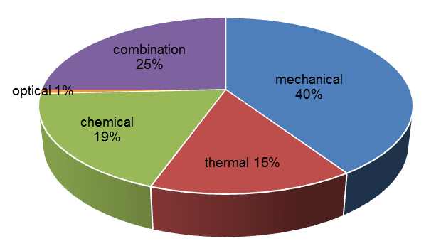
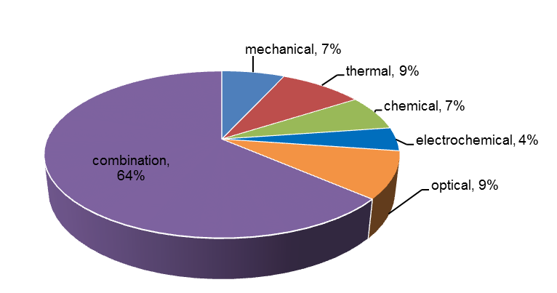
Patent Analysis
Overview of Technology R&D
Procedure
Initial search → 6,465 patents → Screening → 178 effective patents* → analysis (based on targeted components, processing method, and recovered materials)
*directly related to PV recycling
Delamination is a key recycling step including:
c-Si
Separation and recovery of glass, Si cells, and other metals
Thermal, mechanical and chemical approaches can be used.
Analysis results
c-Si – 128 effective patents
45% focusing on module separation
Mechanical method for 40%
Many patents for recovery of components, not for recovery of individual materials.
Thin-film compound – 44 effective patents
High value recycling recovers higher fraction of the mass
Combination method for 64%
Total recycling from module separation to material recovery.
Thin-film compound
Recovery of cover and substrate glass with the semiconductor layer
c-Si
Thermal, mechanical and optical approaches can be used.
Thin-film
compound

